Slide 1
Full Stack Application Development
Web Protocols
HTTP
AJAX and Fetch API
Akshaya Ganesan

Slide 2
Fetch API
Axios

Slide 3
Fetching data from the server
How do you call a service from a client?
The browser makes one or more HTTP requests to the server for the files needed to display the page, and the server responds with the requested files.
The browser reload the page with the new data.
So, instead of the traditional model, many websites use JavaScript APIs to request data from the server and update the page content without a page load.
This is called AJAX
The Fetch API enables JavaScript on a page to request an HTTP server to retrieve specific resources.

Slide 4
Fetch API
The Fetch API provides an interface for fetching resources
Provides a generic definition of Request and Response objects
The fetch() method takes one mandatory argument, the path to the resource you want to fetch.
It returns a promise that resolves to the response of that request (successful or not).
You can optionally pass an init options object as a second argument (used to configure req headers for other types of HTTP requests such as PUT, POST, DELETE)

Slide 5
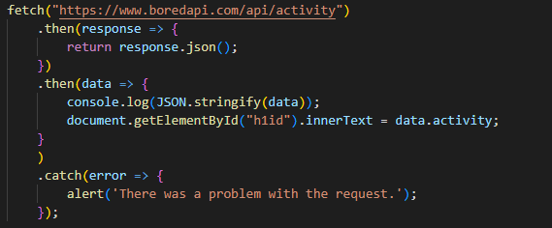
Fetch API Example

Slide 6
Axios
Axios is a promise-based HTTP client for JavaScript.
It allows you to
Make XMLHttpRequests from the browser
Make http requests from node.js
Supports the Promise API
Automatic transforms for JSON data

Slide 7
Axios
Axios provides more functions to make other network requests as well,
matching the HTTP verbs that you wish to execute, such as:
axios.post(<uri>, <payload>)
axios.put(<uri>, <payload>)
axios.delete(<uri>, <payload>)

Slide 8
Fetch vs Axios
Fetch API is built into the window object, and therefore doesn’t need to be installed as a dependency or imported in client-side code.
Axios needs to be installed as a dependency.
However, it automatically transforms JSON data.
If you use .fetch() there is a two-step process when handing JSON data.
The first is to make the actual request and then the second is to call the .json() method on the response.

Slide 9
Fetch API
Axios

Slide 10
Thank You!

